Slide 1
Loan fraud detection
using
Supervised Learning Classification
Presented by
Gopi Selvaraj

Slide 2
Problem Definition
All bank branches across India provide MUDRA loans. Such loans have created the low-cost credit concept for micro and small businesses. One of the leading financial institutions in India wants to leverage Machine Learning techniques to determine the client’s loan repayment abilities and take proactive steps to reduce the magnitude of exposure to default in future.
The goal of the problem is to predict whether a client will default on the loan payment or not, given the recent data of all the loan transactions. This can help the institution to distinguish future applicants who might default. For each ID in the Test Dataset, you must predict the “Default” level.

Slide 3
Data dictionary
S.No | Field name | Description | Data type | Data type change
1 | Date_Of_Disbursement' | The date on which the lender promises to transfer the sanctioned loan amount to the borrower's account. | Object | datetime64
2 | Business | Whether the business is 'Existing' or 'New' | Object
3 | Jobs_Reatained | No. of permanent, full-time employee position that is in existence as of the date of the loan application | Int64
4 | Jobs_Created | No. of permanent, full-time employee position that the business has created as of the date of the loan application | Int64
5 | Year_Of_Commitment | Year in which the loan was sanctioned | Object | Int32
6 | Guaranteed_Approved_Loan | Guaranteed approved loan amount. | Object | Float64
7 | Borrower_Name | Name of the borrower of the loan | Object
8 | Low_Documentation_Loan | Potential borrower to apply for a mortgage while providing little or no information regarding their employment, income, or assets | Object
9 | Demography | Statistical study of human populations, especially with reference to size and density, distribution, and vital statistics | Object
10 | State_Of_Bank | To which state the bank belongs to. | Object
11 | ChargedOff_Amount | When a borrower defaults on a loan, refers to the amount of money that a lender has declared as unlikely to be collected from the borrower. | Object | Float64
12 | Borrower_City | City where the borrower resides | Object
13 | Borrower_State | State where the borrower resides. | Object
14 | Gross_Amount_Balance | Remaining money to be paid to the lender | Object | Float64
15 | Count_Employees | No. of employees working in the organization. | Int64
16 | Classification_Code | This may be a unique code that maybe assigned to a loan taken. | Int64 | Object
17 | Loan_Approved_Gross | Approved loan amount | Object | Float64
18 | Gross_Amount_Disbursed | Gross amount paid to the person. | Object | Float64
19 | Loan_Term | Time period for the loan in months. | Int64
20 | Commitment_Date | Date within which the loan amount must be paid | Object | datetime64
21 | Primary_Loan_Digit | This may be a unique identifier that maybe assigned to a loan taken | Int64
22 | Code_Franchise | Code of the loan provided franchise. | Int64 | Object
23 | Name_Of_Bank | Indicator whether the card was present during the transaction. | Object
24 | Revolving_Credit_Line | Indicator whether the POS was on the merchant's premises. | Object
25 | Default | Indicator for recurring authorization. | Int64 | Object

Slide 4
Shape and distribution of the target variable
The dataset has 105000 observation & 25 variables.
The complexity is in finding the solution to the problem based on the chosen techniques, to handle the
‘Curse of dimensionality’ of the data (considering the data has 25 columns).
When calculating the distribution of the target variable, we can see the
Majority class is ‘Not-default’ / ‘False’
Minority class is ‘Default’ / ‘True’
with a ratio of 72% : 28%
Since the target variable is 'Categorical', we will be building a Supervised Learning Classification model.
Python Version:
‘3.11.7 | packaged by Anaconda, Inc.
Dropping Variables
None of the variables have been dropped considering the % of the missing values in each of the columns.

Slide 5
Excluded Variables
Excluding the below variables from the dataset, as they are irrelevant to the target variable and further may
introduce unwanted confusion during model building:
DateOfDisbursment | Year_Of_Commitment
Borrower_Name | State_Of_Bank
Borrower_City | Borrower_State
Classification_Code | Code_Franchise
Primary_Loan_Digit | Commitment_Date
Name_Of_Bank | Gross_Amount_Balance

Slide 6
Missing Value Imputation
There were 5 currency columns where 'Rs.' which was removed from the column values & data type 'Object' converted to 'Float’
Guaranteed_Approved _Loan
ChargedOff_Amount
Gross_Amount_Balance
Loan_Approved_Gross
Gross_Amount_Disbursed
There was 1 column which was renamed appropriately.
Jobs_Reatained : 'Jobs_Retained’
There were 2 columns with data type 'Object' converted to 'Datetime’
Date_Of_Disbursement
Commitment_Date
There were 3 columns with data type 'Int' converted to 'Object' (categorical variable)
Classification_Code
Code_Franchise
Default (Target variable)
There were 2 columns with mismatched values which have been rectified
'Year_Of_Commitment' : 1976A -> 1976
'Borrower_State' : Removed white spaces within Subclasses
There was 1 column with data type 'Object' converted to 'Int’
- 'Year_Of_Commitment'

Slide 7
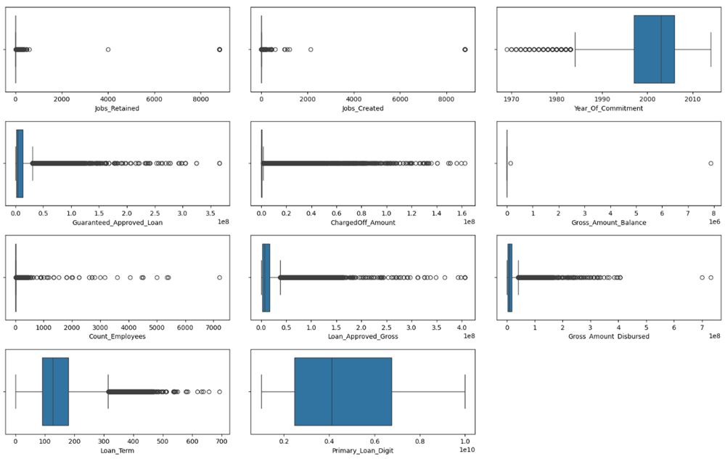
Exploratory Data Analysis
Univariate analysis - Numeric variables
BOX PLOT: (Detection of IQR, Minimum, Maximum, 25%, 50%, 75% & outliers in a numeric column)

Slide 8
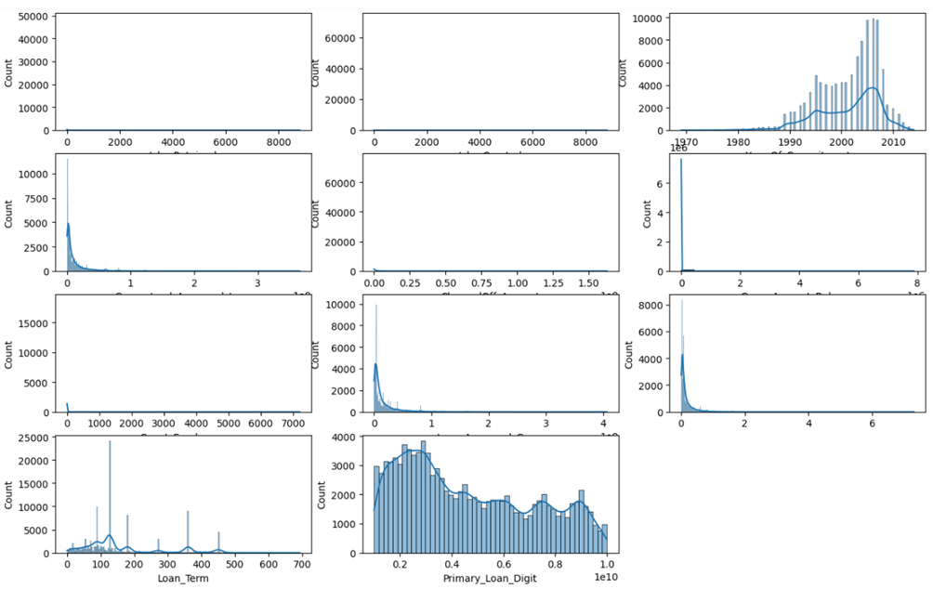
HISTOGRAM: (Detect skewness; visualize the distribution of the data; detect the position of mean median & mode)

Slide 9
Inference:
'Jobs_Retained’
Distribution of data : Extreme positive skewness (32.33),
indicating presence of outliers the in higher scale.
50% of the values lie around 4
We can observe huge no. of outliers & extreme outlier values of 4000 & 8800
'Jobs_Created’
Distribution of data : Extreme positive skewness (32.41),
indicating presence of outliers in the higher scale.
50% of the values lie around 1
We can observe huge no. of outliers & extreme outlier values of 2100 & 8800
'Year_Of_Commitment’
Distribution of data : Moderate negative skewness (-0.75),
indicating presence of outliers in the lower scale.
50% of the values lie around 2004
We can observe huge no. of outliers & an extreme outlier value of 1969
'Guaranteed_Approved_Loan’
Distribution of data : Extreme positive skewness (3.8),
indicating presence of outliers in the higher scale.
50% of the values lie around 11541760
We can observe huge no. of outliers & an extreme outlier value of 365760000
‘ChargedOff_Amount’
Distribution of data : Extreme positive skewness (8.9),
indicating presence of outliers in the higher scale.
50% of the values lie around 617016
We can observe huge no. of outliers & an extreme outlier value of 162559918.7

Slide 10
'Gross_Amount_Balance’
Distribution of data : Extremely positively skewed (323.8),
indicating presence of outliers in the higher scale.
Almost all of the values are 0 and only two other values are present (143052.8 & 7876682.2)
We can observe an extreme value of 7876682.2
'Count_Employees’
Distribution of data : Extremely positively skewed (68),
indicating presence of outliers in the higher scale.
50% of the values lie around 7
We can observe an extreme value of 7200
'Loan_Approved_Gross’
Distribution of data : Extremely positively skewed (3.7),
indicating presence of outliers in the higher scale.
50% of the values lie around 14305280
We can observe huge no. of outliers & an extreme outlier value of 162559918.7
‘Gross_Amount_Disbursed’
Distribution of data : Extremely positively skewed (4.2),
indicating presence of outliers in the higher scale.
50% of the values lie around 14874585.4
We can observe huge no. of outliers & an extreme outlier value of 731113600
‘Loan_Term’
Distribution of data : Extremely positively skewed (1.2),
indicating presence of outliers in the higher scale.
50% of the values lie around 90
We can observe huge no. of outliers & an extreme outlier value of 692
'Primary_Loan_Digit’
Distribution of data : Near normal distribution & no outliers (no skewness)
50% of the values lie around 4282320745.2- We can't observe any outliers.
This column doesn't make sense as a predictor variable because it is just a unique identifier assigned to each loan taken.

Slide 11
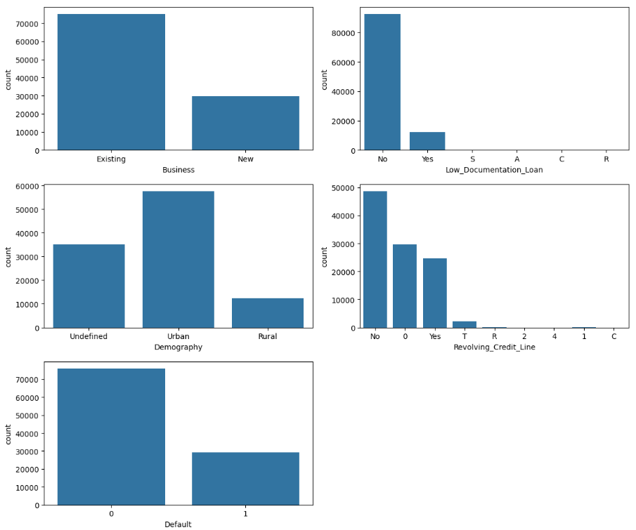
Univariate analysis - Categorical variables
COUNT PLOT: (Visualize each of the subclasses total count in the form of a bar chart)

Slide 12
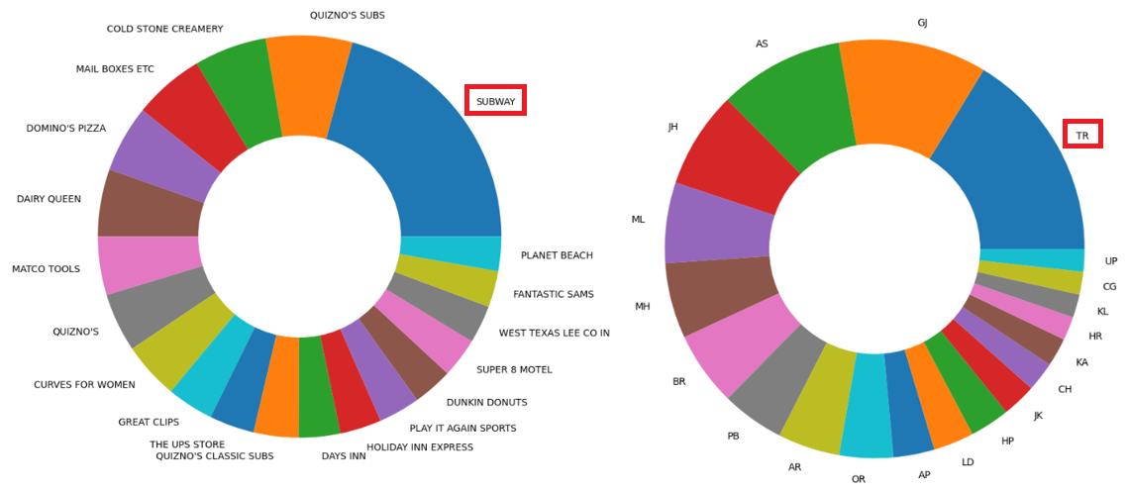
PIE PLOT: (Considering the huge no. of subclasses for the below variables we have decided to use a
Pie plot to represent the top 10 sub-classes and visualized them)
‘Borrower_Name’
‘State_Of_Bank’

Slide 13
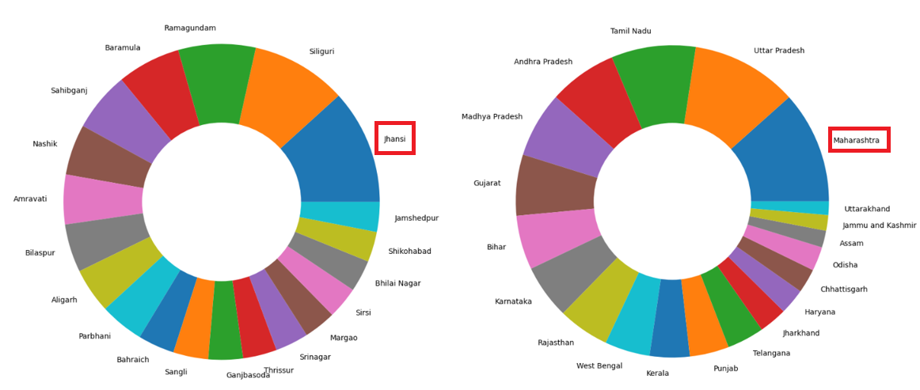
‘Borrower_City’
‘Borrower_State’

Slide 14
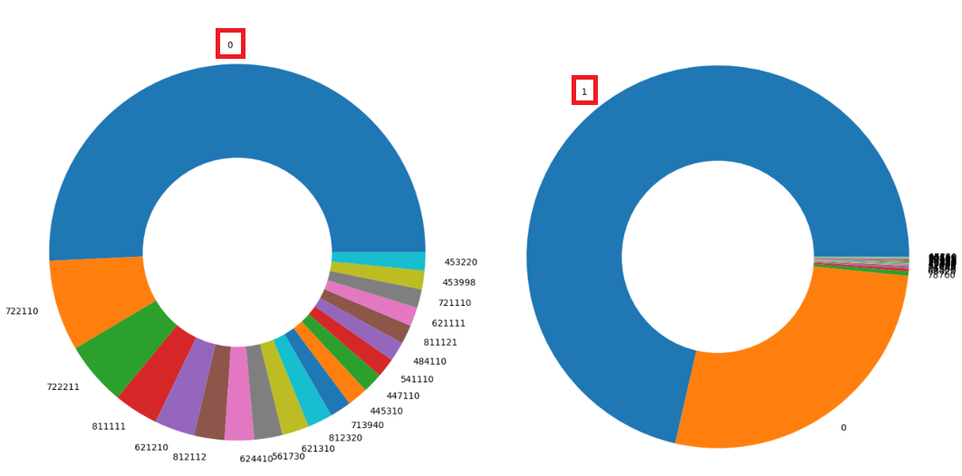
‘Classification_Code’
‘Code_Franchise’

Slide 15
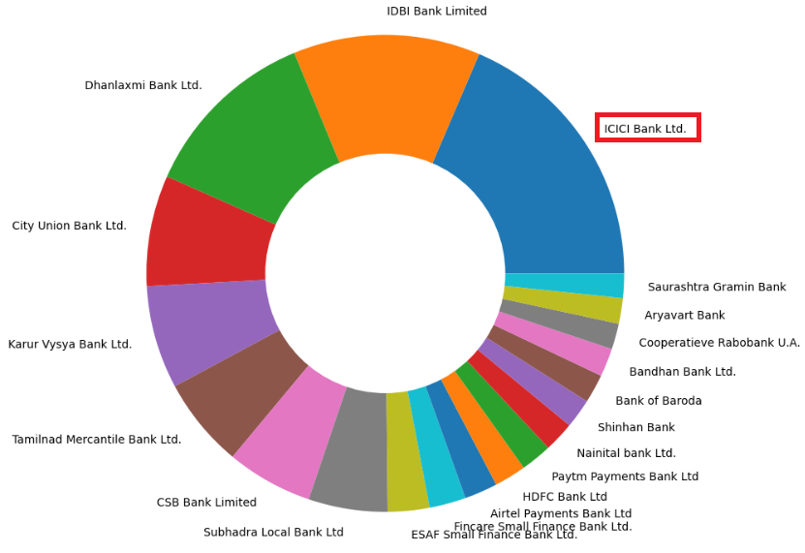
‘Name_Of_Bank’

Slide 16
Inference:
'Business’
Most of the loans were taken by businesses which are already 'Existing' (75211)
Least no. loans were taken by business which are 'New' (29789)
There is high imbalance in subclasses & bias towards 'Existing’
'Low_Documentation_Loan’
Most of the loans had opted 'No’ (92675) for ‘Low_Documentation_Loan’
Least no. of values are 'R' (6)
There is high imbalance in subclasses & bias towards 'No’
‘Demography’
Most of the loans were taken from 'Urban’ areas (57598)
Least no. of loans were taken from 'Rural’ areas (10000)
There is high imbalance in subclasses & is bias towards ‘Rural’
'State_Of_Bank’
Most of loans were provided by banks from the state 'TR' (15552)
Least no. of loans were provided by banks from the state 'MN' (18)
'Borrower_City’
Most of the loans are taken from the city 'Jhansi' (1504)
Least no. of loans are taken from the city 'Mudhol' (19)

Slide 17
'Borrower_State’
Most of the loans were taken by people belonging to the states of 'Maharashtra' (11699) & 'Uttar Pradesh' (11101)
Least no. of loans were taken by people belonging to the state 'Bulandshahr' (34)
'Classification_Code’
Most of the loans belonged to classification code '0' (22209)
This column doesn't make sense in terms of actual predictor variable, but rather to be an unique identifier.
'Code_Franchise’
Most of the loans belonged to code franchise '1' (71874)
This column doesn't make sense in terms of actual predictor variable, but rather to be an unique identifier.
'Name_Of_Bank’
Most of the loans were provided by 'ICICI Bank Ltd.' (11215)
Least no. of loans were provided by 'Barclays Bank Plc.' (93)
'Revolving_Credit_Line’
Most of the values belong to 'No' (48616)
Least no. of values belong to '2' , '4', 'C' (1)
'Default’
Most of the loans were ‘Not-default’ [ '0’ = 75896] (72%)
Least no. the loans were ‘Default’ [ '1’ = 29104] (28%)

Slide 18
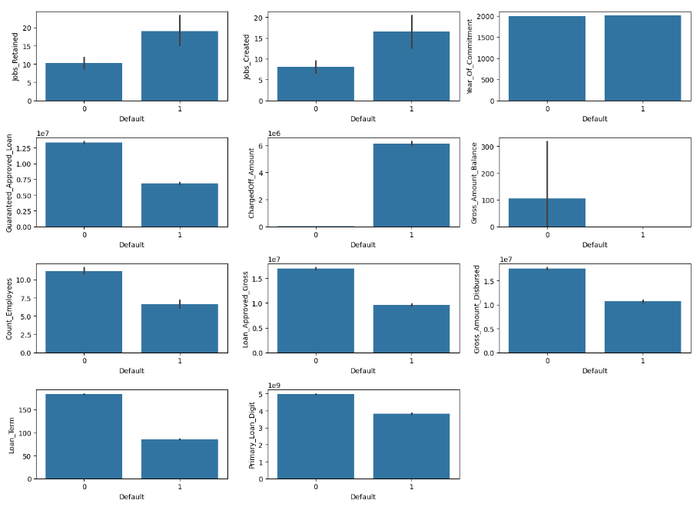
Bivariate analysis – Numerical VS Categorical
BAR PLOT: [Seaborn bar plot gives the mean of each subclass (of the target variable) in regards to the numeric variable]

Slide 19
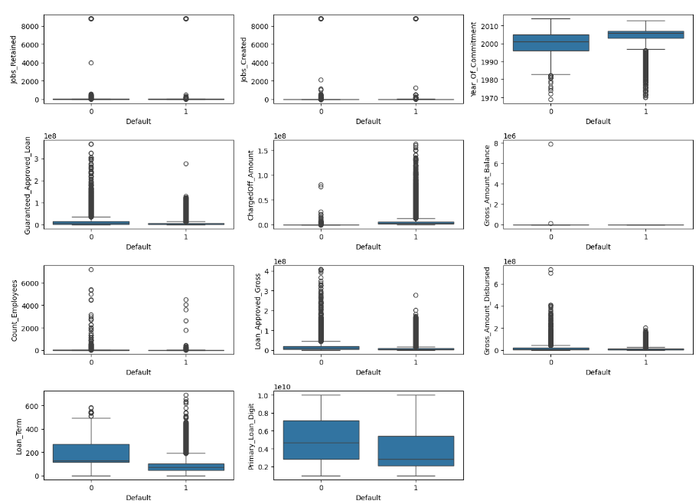
BOX PLOT: (Detection of IQR, distribution, Minimum, Maximum, 25%, 50%, 75%, outliers of each subclass of the target
variable in regards to the numeric variable)

Slide 20
Inference:
'Jobs_Retained' VS 'Default’
On average we can see companies who have retained jobs have more ‘Default’ (18.9) than companies with
'Not-default’ (10.2)
This may be due to the company needed to payout the salary of the employees but didn't return a profit on their respective business.
50% of the data ‘Not-default' lies around 4 & ‘Default' lies around 5.
Similar distribution of data between the target variable subclasses.
There seems to be relationship between these two variables.
'Jobs_Created' VS 'Default’
On average we can see companies who have created jobs have more ‘Default’ (16.5) than companies with
‘Not-default’ (8)
This may be due to the company which has created more jobs & is required payout the salary of the employees but didn't return a profit on their respective business.
50% of the data ‘Not-default' lies around 1 & ‘Default' lies around 2.
Similar distribution of data between the target variable subclasses
There seems to be relationship between these two variables.
'Year_Of_Commitment' VS 'Default’
Considering the average, there doesn't seem to be significant relationship between 'Year_Of_Commitment' & 'Default’
50% of the data ‘Not-default' lies around 9 & ‘Default' lies around 4

Slide 21
'Guaranteed_Approved_Loan' VS 'Default’
On average we can see people who have got high 'Guaranteed_Approved_Loan' have
‘Not-default’ (6822169) but people with lower value have 'Defaults’ (13317860)
50% of the data ‘Not-default' lies around 13817600 & 'Loan default' lies around 5486400
There seems to be relationship between these two variables.
'ChargedOff_Amount' VS 'Default’
On average we can see people who have got high 'ChargedOff_Amount' have 'Defaults' (6146350) & low 'ChargedOff_Amount' have ‘Not-default’ (11430.1)
50% of the data ‘Not-default' lies around 0 & ‘Default' lies around 4797592.6
There seems to be relationship between these two variables.
'Gross_Amount_Balance' VS 'Default’
On average we can see people with high 'Gross_Amount_Balance' have ‘Not-default' (105.6) & people with low 'Gross_Amount_Balance' have 'Default' (6.5)
There seems to be relationship between these two variables.
'Count_Employees' VS 'Default’
On average we can see companies with more employees have ‘Not-default' (11.1) while companies with low no. of employees have 'Default' (6.5)
50% of the data ‘Not-default' lies around 8 & ‘Default' lies around 4
There seems to be relationship between these two variables.

Slide 22
'Loan_Approved_Gross' VS 'Default’
On average we can see companies who got high 'Loan_Approved_Gross' have ‘Not-default' (16954400) compared to people with low 'Loan_Approved_Gross' who have ‘Default’ (9622007).
50% of the data ‘Not-default' lies around 17068800 & ‘Default' lies around 6096000
There seems to be relationship between these two variables.
'Gross_Amount_Disbursed' VS 'Default’
On average people with high 'Gross_Amount_Disbursed' have ‘Not-default' (17536700) while people with 'Gross_Amount_Disbursed' have 'Default' (10689470)
50% of the data 'Not loan default' lies around 16662400 & ‘Default' lies around 9207093.6
There seems to be relationship between these two variables.
'Loan_Term' VS 'Default’
On average people with high 'Loan_Term' have ‘Not-default’ (183.5) while people with low 'Loan_Term' have 'Default' (85.6)
50% of the data ‘Not-default' lies around 153 & ‘Default' lies around 59.
'Primary_Loan_Digit' VS 'Default’
- This column can be just a unique identifier that we may consider discarding that might not be a good predictor variable.

Slide 23
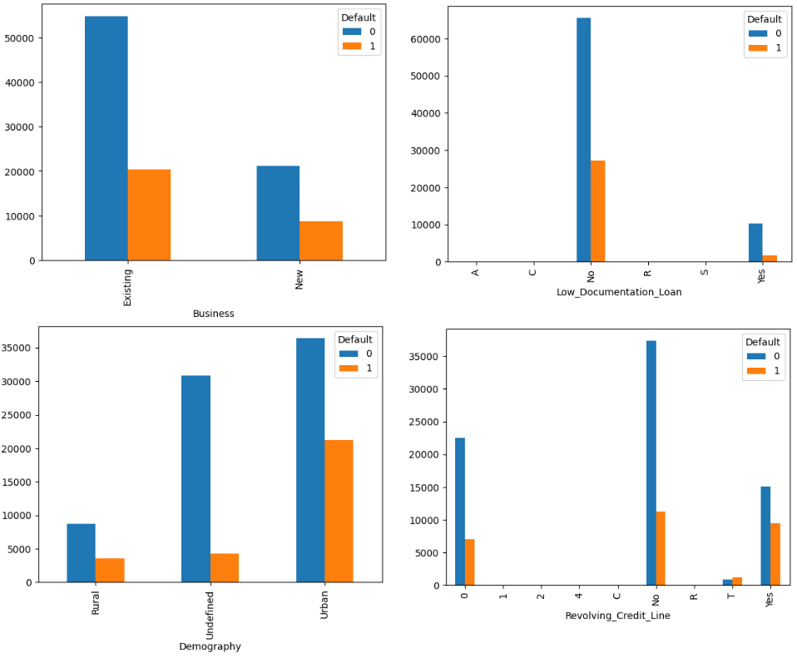
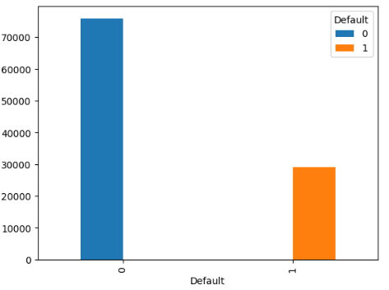
Bivariate analysis
Categorical VS Categorical
CROSS TABULATION
(Understand the relationship between two categorical variables)

Slide 24
Inference:
'Business' VS 'Default’:
We can see most of the existing 'Business' (20386) have 'Default' compared to the 'New' business who have less 'Default' (8718)
There seems to be a relationship between the two variables.
'Low_Documentation_Loan' VS 'Default’:
We can see most of the companies who "Don't" have 'Low_Documentation' have 'Default' (27191).
We can also see considerable no. of companies 'Have' 'Low_Documentation' have 'Default' (1803).
There seems to be a relationship between the two variables.
'Demography' VS 'Default’:
We can see most of the 'Urban' (21223) companies have 'Default' compared to the 'Rural' (3613) companies.
'Revolving_Credit_Line' VS 'Default’ :
We can see most of the companies who dont have a 'Revolving_Credit_Line' have the highest no. of ‘Default’ (11312) followed by companies who 'Have a' 'Revolving_Credit_Line'(9495).
Third place is held by '0' subclass (7055)

Slide 25
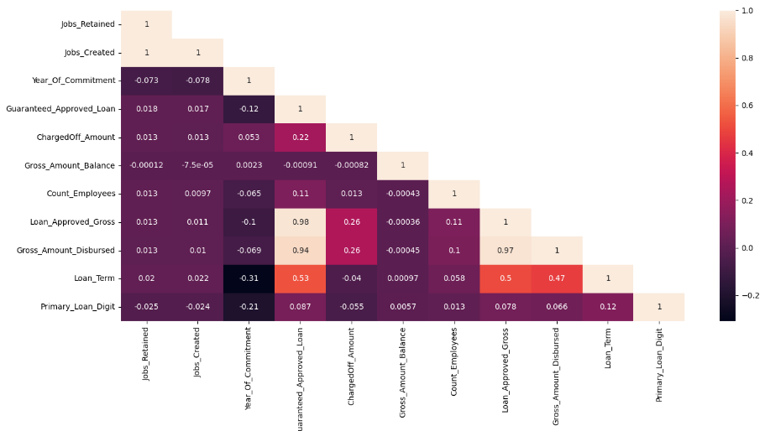
Multivariate analysis
Correlation matrix : (Visualize the correlation between the numeric variables)
Inference:
We can infer the presence of Multi-collinearity (existence of correlation between the independent / 'x' variables) from the correlation matrix.
We can observe high positive correlation between:
'Loan_Approved_Gross' & 'Guaranteed_Approved_Loan' (0.98)
'Gross_Amount_Disbursed' & 'Guaranteed_Approved_Loan' (0.94)
We can observe moderate positive correlation between:
'Loan_Term' & 'Guaranteed_Approved_Loan' (0.53)
'Loan_Term' & 'Loan_Approved_Gross' (0.5) 'Loan_Term' & 'Gross_Amount_Disbursed' (0.47)
We can observe weak positive correlation between:
'Loan_Approved_Gross' & 'Charged_off_Amount' (0.26)
'Gross_Amount_Disbursed' & 'Charged_off_Amount' (0.26)
We can observe weak negative correlation between:
'Loan_Term' & 'Year of commitment’ (-0.31)
'Primary_Loan_Digit' & 'Year of commitment’
(-0.21)

Slide 26
Statistical test of significance:
Since the data has failed to meet the assumptions
(i) Data normality (Shapiro test)
(ii) Data has equal variance (Levene test)
we have opted for Non-parametric test to try to understand if any relationship exists between the independent variables and dependent variable.
Numeric VS Categorical – Mann -Whiteney U (Non-Parametric)
Categorical VS Categorical – Chi square contingency test (Non-Parametric)
Statistically significant numeric columns:
'Jobs_Retained’
'Jobs_Created’
'Guaranteed_Approved_Loan’
'ChargedOff_Amount’
'Count_Employees’
'Loan_Approved_Gross’
'Gross_Amount_Disbursed’
'Loan_Term’
Statistically significant categorical columns:
'Business’
'Low_Documentation_Loan’
'Demography’
'Revolving credit line'

Slide 27
Data preprocessing
Scaling the data
Scaling is performed in the dataset for the numeric variables after train test split as we can hide the mean standard deviation of training data from the test data.
Scaling has been performed as part of one of Yeo-Johnson transformation (which performs both scaling & transformation)
Outlier treatment:
The popular methods of handling the outliers are Trimming/removing the outlier based on IQR or z-Score or capping them.
But, we would like to consider the outliers in this dataset as a pattern and prefer not to treat them but to handle them differently since it is important for the model to get trained based on some extreme values in order to predict in an efficient way consider their nature in the financial sector.
Transformation technique:
We prefer transformation of the numeric variables (using Yeo-Johnson transformation) so that we can try to convert them to near normal distribution.

Slide 28
Encoding the Categorical Variables:
The performance of a machine learning model not only depends on the model and the hyperparameters but also on how we process and feed different types of variables to the model. Since most machine learning models only accept numerical variables, pre-processing the categorical variables becomes a necessary step. Converting these categorical variables to numbers such that the model is able to understand and extract valuable information is known as Encoding. There are various encoding techniques available like Dummies, One Hot Encoder, Label Encoder, Ordinal Encoder etc., We have used Label Encoder for encoding our categorical variables considering the no. of categorical variables and we have also seen there is not a significant improvement in model performance when dummy encoding was utilized.
We have utilized Label encoding technique. In this case, retaining the order is important. Hence encoding should reflect the sequence. In Label encoding, each label is converted into an integer value. We will create a variable that contains the categories representing the education qualification of a person likewise.
The final processed data which we would be using in building various Classification Models like Logistic Regression, Decision Tree, Random Forest etc. We, with the help of the built models we would infer on the significance and effects of each independent variable on our target variable for predicting the patterns and rate of successful conversion to give some insightful ideas for effective marketing.

Slide 29
Model Building & Evaluation
The Modeling is the core of any machine learning project. This step is responsible for the results that should satisfy or help satisfy the project goal.
Building a model in machine learning is creating a mathematical representation by generalizing and learning from training data.
Our problem statement come under the Classification thus we have decided to use various models namely
Logistic Regression Model
Decision Tree Model
Random Forest Model
Ada Boost Technique
Gradient Boosting Technique
Extreme Gradient Boosting Technique
Evaluation metrics: Recall, Precision, Accuracy & F1 Score (weighted). Due to imbalance in the subclass of the target variable we have opted for weighted evaluation metrics which will give us the correct representation of the metrics thereby will estimate the model performance appropriately.

Slide 30
Hyper tuning the model
Model: Decision Tree Classifier
GridSearchCV (run for below parameters)
Criterion | Entropy, Gini
Max Depth | 30, 35, 40
Min Samples Split | 50, 60, 70, 80, 90
Min Samples Leaf | 10, 20, 30, 40
Best Parameters
Criterion | Entropy
Max Depth | 30
Min Samples Split | 80
Min Samples Leaf | 10

Slide 31
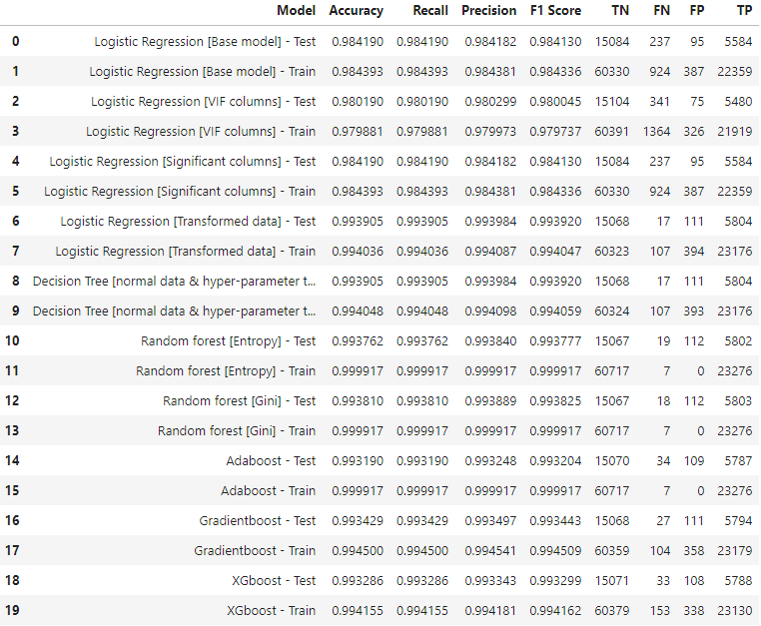
Model performance – Test & Training scores

Slide 32
Best models that have been achieved without SMOTE
Random Forest (Entropy)
Random Forest (Gini)
Decision tree (Hyper-tuned)

Slide 33
Top important Features from best Model:
1. Jobs_Retained
2. Jobs_Created
3. Guaranteed_Approved_Loan
4. ChargedOff_Amount
5. Count_Employees
6. Loan_Approved_Gross
7. Gross_Amount_Disbursed
8. Loan_Term
9. Business
10. Low_Documentation_Loan
11. Demography
12. Revolving_Credit_Line

